Slide 1
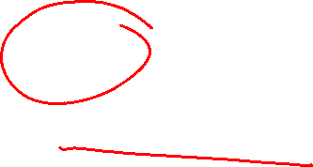
Section 11.9 Representations of Functions as Power Series
Lecture 1
Functions as Power Series

Slide 2

Section Homework Submission to Canvas
Preview of section​
Skim section, write short paragraph summary, list all important definitions / theorems / formulas.​
Notes on video lectures​
Include all details, worked examples, your own thoughts​
Worked examples from text​
Solutions to exercises​
Final reflection of section​
List of key takeaways to remember​

Slide 3
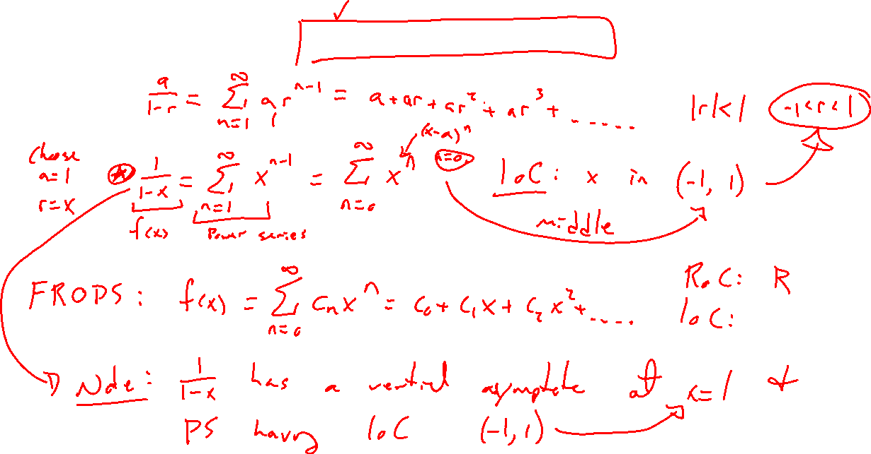
Base Example: Geometric Series
Notes:
Reminder of geometric series formula.
Transfer to function 1/(1-x)
Remind of interval of convergence.
Graph in desmos and note vertical asymptote

Slide 4
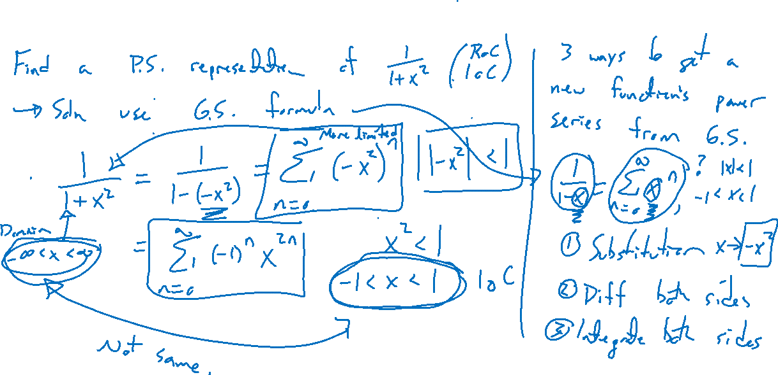
Example: New Functions by Substitution
Notes:
1/(1+x^2)
Note it doesn't converge everywhere despite no vertical asymptote.
Reason is extension into the complex plane, asymptote there.

Slide 5
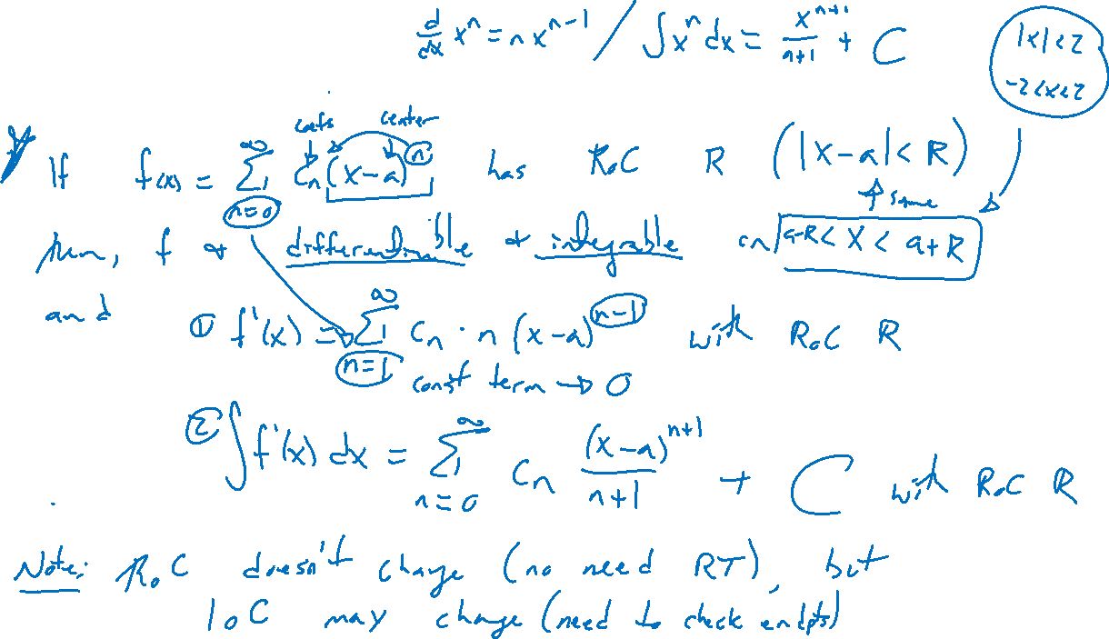
Theorem: Differentiating and Integrating Power Series
Notes:
Radius of convergence is same, not the IOC endpoints may change

Slide 6
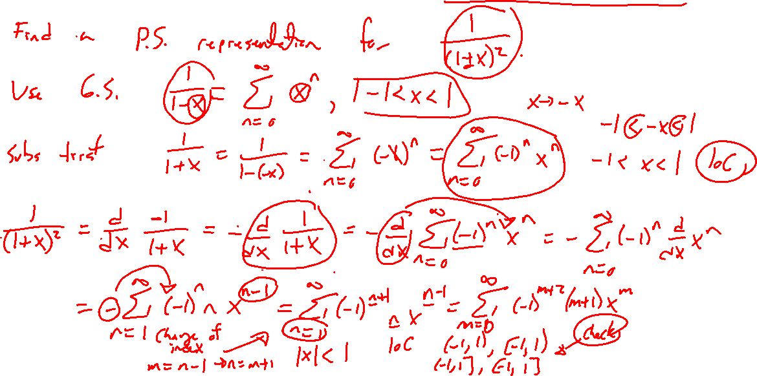
Example: New Functions by Differentiation
Notes:
1/(1+x)^2
Radius for free. Check endpoints for IOC.
Note possibly shift of index for starting n value.

Slide 7
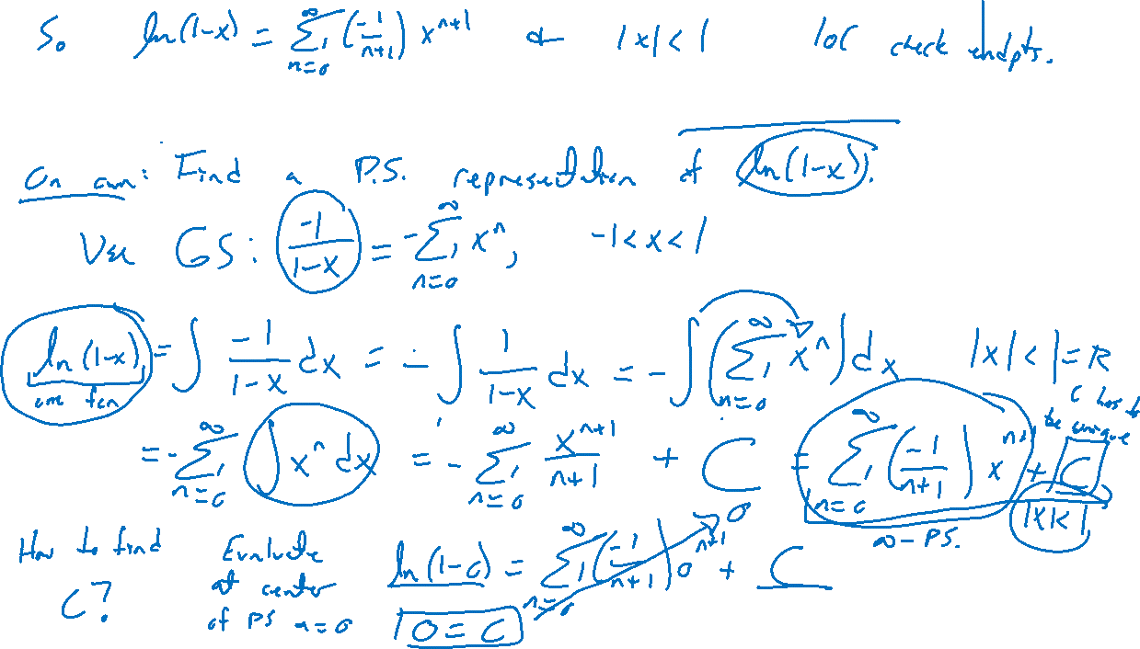
Example: New Functions by Integration
Notes:
Try on own.
ln(1-x).
Note constant of integration.
Again, endpoints may change.
Test out in desmos
Arctangent and machins formulas

Slide 8
Section 11.9 Examples and Homework
Rework textbook examples: 2, 3, 5, 6, 7, 8
Write down problem.
Close book and attempt on own.
Compare your solution to text solution, improve your writing.
Exercises: 5, 7, 13, 15, 17

Slide 9

Section Homework Submission to Canvas
Preview of section​
Skim section, write short paragraph summary, list all important definitions / theorems / formulas.​
Notes on video lectures​
Include all details, worked examples, your own thoughts​
Worked examples from text​
Solutions to exercises​
Final reflection of section​
List of key takeaways to remember​

